Slide 1

Deadlock detection, prevention and recovery
Database Management System | Transaction Management and Scheduling
Course: Database Management System | Chapter: Transaction Management and Scheduling | Program: B.TECH-CSE, B.TECH CSE - CYBER SECURITY, B.TECH CSE - DATA
DISCOVER · LEARN · EMPOWER
Notes:
Welcome everyone to today's lecture on Transaction Management. We will dive deep into a critical challenge in concurrent systems: the deadlock. Understanding how to detect, prevent, and recover from deadlocks is essential for building robust database applications. Let us begin our journey into the mechanics of transaction scheduling.

Slide 2
Course Outcomes
SLIDE 2 / 14
Course Outcome
CO | BT LEVEL | DESCRIPTION
CO1 | BT2 | Explain database architecture, relational model concepts and formal query language foundations including relational algebra and relational calculus.
CO2 | BT3 | Apply relational algebra, relational calculus and SQL constructs to formulate correct and efficient database queries.
CO3 | BT4 | Analyze functional dependencies and design normalized relational schemas up to 5NF ensuring lossless join and dependency preservation.
CO4 | BT4 | Analyze transaction schedules and concurrency control mechanisms to determine serializability, recoverability and correctness.
CO5 | BT5 | Evaluate storage structures, indexing strategies and query optimization techniques for performance, scalability and reliability.
Chandigarh University
2 / 14
Notes:
Today's session directly supports our Course Outcomes. CO3 ensures you understand schema design, while CO4 focuses on the concurrency control mechanisms we are discussing now. Specifically, we will analyze how deadlock affects the correctness and recoverability of transaction schedules. This knowledge is vital for ensuring system reliability.

Slide 3
Learning Objectives
SLIDE 3 / 14
Learning Outcomes
1
Define deadlock and identify its four necessary conditions in a system.
2
Analyze the Wait-For Graph method for detecting existing deadlocks.
3
Evaluate prevention strategies like wait-die and wound-wait algorithms.
4
Demonstrate recovery procedures using rollback and victim selection.
5
Compare the trade-offs between detection overhead and prevention strictness.
Chandigarh University
3 / 14
Notes:
By the end of this lecture, you will be able to define a deadlock and list its four necessary conditions. You will learn to construct a Wait-For Graph to detect cycles. We will also evaluate prevention strategies and demonstrate recovery procedures using rollback mechanisms. Finally, we will compare the trade-offs between detection and prevention.

Slide 4
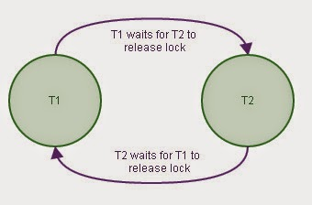
Lecture
SLIDE 4 / 14
Definition and Necessary Conditions
1
A deadlock occurs when two or more transactions wait indefinitely for each other.
2
Mutual exclusion requires resources to be held exclusively by one transaction.
3
Hold and wait happens when a transaction holds resources while waiting for others.
4
No preemption means resources cannot be forcibly taken from a transaction.
5
Circular wait exists when a chain of transactions waits for each other.
6
All four conditions must hold simultaneously for a deadlock to occur.
Deadlock detection technique in Database | Explore Database
Chandigarh University
4 / 14
Notes:
A deadlock is a state where transactions are stuck waiting forever. For this to happen, four conditions must be met simultaneously. Mutual exclusion means a resource cannot be shared. Hold and wait means a transaction keeps holding resources while asking for more. No preemption means the system cannot force a transaction to release a resource. Finally, circular wait creates a cycle where T1 waits for T2, which waits for T1.

Slide 5
Lecture
SLIDE 5 / 14
Wait-For Graph Structure
1
A Wait-For Graph is a directed graph representing transaction dependencies.
2
Nodes in the graph represent active transactions in the system.
3
A directed edge from Ti to Tj means Ti is waiting for Tj.
4
The graph is dynamic and updates as transactions request or release locks.
5
A cycle in the graph indicates the presence of a deadlock.
6
Detecting a cycle is equivalent to detecting a deadlock in the system.
Chandigarh University
5 / 14
Notes:
To detect deadlocks, we use a Wait-For Graph. Each node represents a transaction, and an edge from Ti to Tj means Ti is waiting for Tj. This graph is dynamic and changes as transactions request or release locks. If we find a cycle in this graph, it indicates a deadlock. For example, if T1 waits for T2, T2 waits for T3, and T3 waits for T1, we have a cycle.

Slide 6
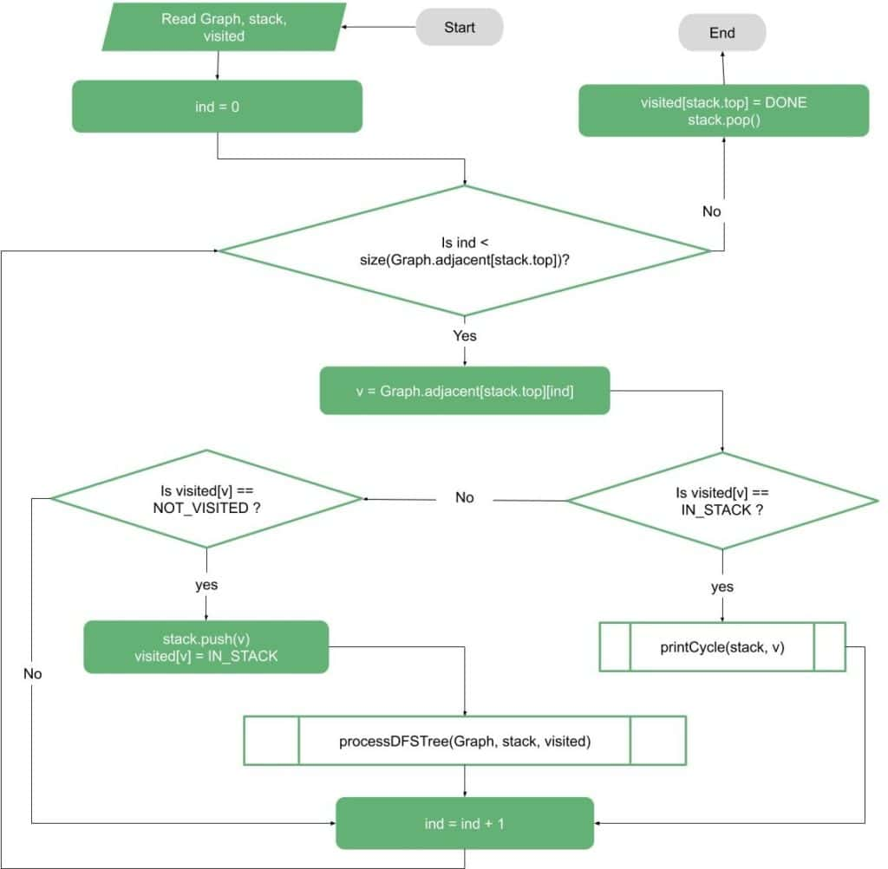
Lecture
SLIDE 6 / 14
Deadlock Detection Algorithm
1
The system periodically runs a cycle detection algorithm on the graph.
2
Depth-First Search (DFS) is commonly used to find cycles efficiently.
3
If a cycle is found, the system declares a deadlock state.
4
The algorithm must handle multiple disjoint cycles in the graph.
5
Detection overhead increases with the number of active transactions.
6
Recovery is triggered immediately after a deadlock is confirmed.
Source: www.baeldung.com
Chandigarh University
6 / 14
Notes:
The system periodically runs a cycle detection algorithm on the Wait-For Graph. Depth-First Search is commonly used to find cycles efficiently. If a cycle is found, the system declares a deadlock state. The algorithm must handle multiple disjoint cycles in the graph. Detection overhead increases with the number of active transactions. Recovery is triggered immediately after a deadlock is confirmed.

Slide 7
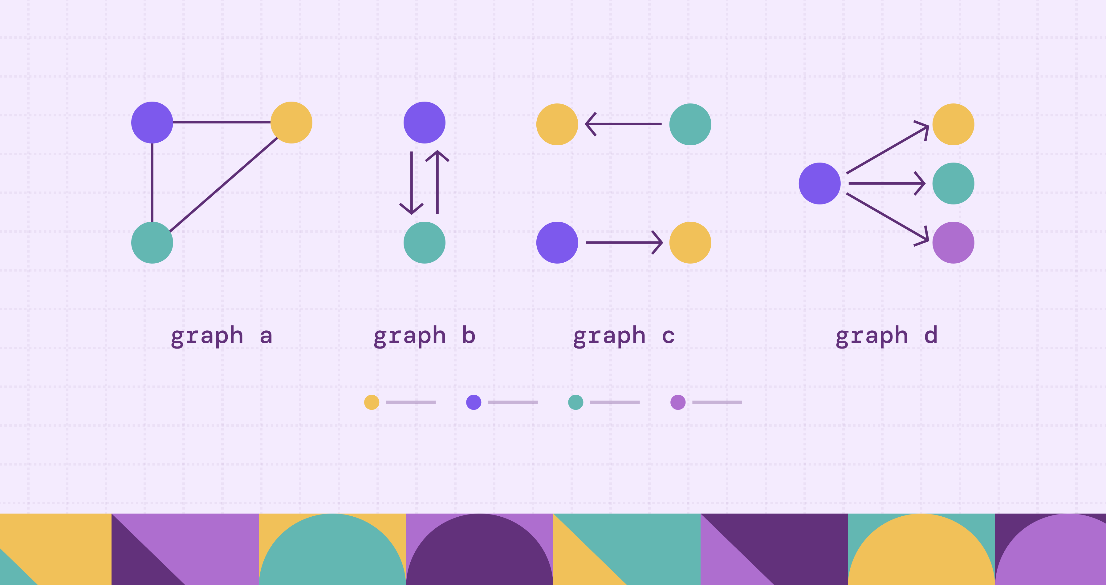
Worked Example
SLIDE 7 / 14
Cycle Detection
THE GRAPH CONTAINS A CYCLE
T1 -> T2 -> T1.
• Transaction T1 holds Lock A and requests Lock B.
• Transaction T2 holds Lock B and requests Lock A.
• Edge T1 -> T2 exists because T1 waits for T2.
• Edge T2 -> T1 exists because T2 waits for T1.
• This cycle confirms a deadlock between T1 and T2.
Source: cdn.prod.website-files.com
Chandigarh University
7 / 14
Notes:
Consider a scenario where T1 holds Lock A and requests Lock B. T2 holds Lock B and requests Lock A. An edge T1 to T2 exists because T1 waits for T2. An edge T2 to T1 exists because T2 waits for T1. The graph contains a cycle: T1 to T2 to T1. This cycle confirms a deadlock between T1 and T2.

Slide 8
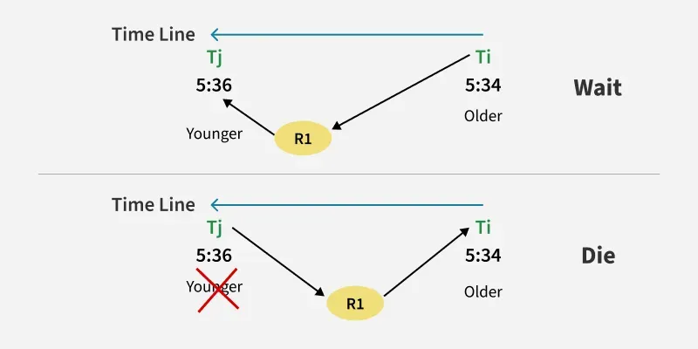
Deadlock Prevention
SLIDE 8 / 14
Wait-Die
1
Wait-Die is a non-preemptive prevention scheme based on timestamps.
2
If an older transaction requests a resource held by a younger one, it waits.
3
If a younger transaction requests a resource held by an older one, it dies.
4
The younger transaction is rolled back and restarted with the same timestamp.
5
This scheme prevents circular wait by breaking potential cycles early.
6
It avoids starvation because older transactions always get priority.
Source: media.geeksforgeeks.org
Chandigarh University
8 / 14
Notes:
Wait-Die is a non-preemptive prevention scheme based on timestamps. If an older transaction requests a resource held by a younger one, it waits. If a younger transaction requests a resource held by an older one, it dies. The younger transaction is rolled back and restarted with the same timestamp. This scheme prevents circular wait by breaking potential cycles early. It avoids starvation because older transactions always get priority.

Slide 9
Deadlock Prevention
SLIDE 9 / 14
Wound-Wait
1
Wound-Wait is a preemptive prevention scheme based on timestamps.
2
If an older transaction requests a resource held by a younger one, it waits.
3
If a younger transaction requests a resource held by an older one, it wounds.
4
The younger transaction is rolled back immediately to release the resource.
5
This scheme ensures older transactions proceed without waiting for younger ones.
6
It may cause more rollbacks than Wait-Die in high contention scenarios.
Source: media.geeksforgeeks.org
Chandigarh University
9 / 14
Notes:
Wound-Wait is a preemptive prevention scheme based on timestamps. If an older transaction requests a resource held by a younger one, it waits. If a younger transaction requests a resource held by an older one, it wounds. The younger transaction is rolled back immediately to release the resource. This scheme ensures older transactions proceed without waiting for younger ones. It may cause more rollbacks than Wait-Die in high contention scenarios.

Slide 10
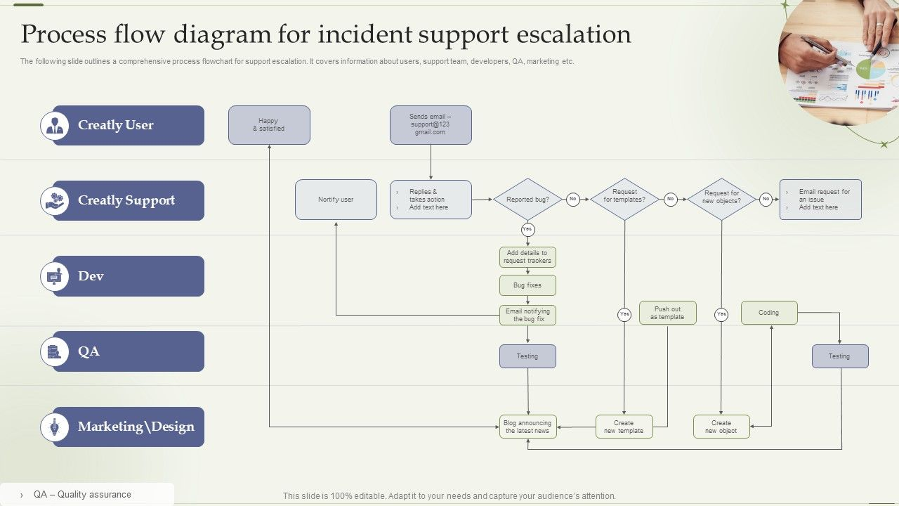
Lecture
SLIDE 10 / 14
Deadlock Recovery Strategies
1
Recovery involves selecting a victim transaction to roll back.
2
The victim is chosen based on cost, age, or resource usage.
3
Rolling back a transaction releases all its held resources.
4
The system must ensure atomicity and consistency after rollback.
5
Partial rollback is possible but complex to implement correctly.
6
Full rollback restarts the transaction from the beginning.
Source: www.slideteam.net
Chandigarh University
10 / 14
Notes:
Recovery involves selecting a victim transaction to roll back. The victim is chosen based on cost, age, or resource usage. Rolling back a transaction releases all its held resources. The system must ensure atomicity and consistency after rollback. Partial rollback is possible but complex to implement correctly. Full rollback restarts the transaction from the beginning.

Slide 11
Lecture
SLIDE 11 / 14
Victim Selection Criteria
1
Select the transaction with the least amount of work done.
2
Choose the transaction that has the lowest priority in the system.
3
Consider the number of resources held by the transaction.
4
Minimize the cost of rolling back the selected transaction.
5
Avoid selecting a transaction that is critical for other processes.
6
Balance the load by rotating victim selection over time.
Chandigarh University
11 / 14
Notes:
Select the transaction with the least amount of work done. Choose the transaction that has the lowest priority in the system. Consider the number of resources held by the transaction. Minimize the cost of rolling back the selected transaction. Avoid selecting a transaction that is critical for other processes. Balance the load by rotating victim selection over time.

Slide 12
Lecture
SLIDE 12 / 14
Common Pitfalls in Prevention
1
Overly strict prevention can lead to low system throughput.
2
Timestamp-based schemes may cause frequent transaction restarts.
3
Ignoring resource ordering can lead to unexpected deadlocks.
4
Failing to update the Wait-For Graph causes detection errors.
5
Not handling partial rollbacks correctly leads to data inconsistency.
6
Assuming prevention is always better than detection is a mistake.
Chandigarh University
12 / 14
Notes:
Overly strict prevention can lead to low system throughput. Timestamp-based schemes may cause frequent transaction restarts. Ignoring resource ordering can lead to unexpected deadlocks. Failing to update the Wait-For Graph causes detection errors. Not handling partial rollbacks correctly leads to data inconsistency. Assuming prevention is always better than detection is a mistake.

Slide 13
Lecture
SLIDE 13 / 14
Key Takeaways
DEADLOCK REQUIRES FOUR CONDITIONS
mutual exclusion, hold and wait, no preemption, circular wait.
• Wait-For Graphs are used to detect cycles indicating deadlocks.
• Wait-Die and Wound-Wait are timestamp-based prevention strategies.
• Recovery involves selecting a victim and rolling back the transaction.
• Prevention reduces deadlocks but may lower system performance.
Chandigarh University
13 / 14
Notes:
Deadlock requires four conditions: mutual exclusion, hold and wait, no preemption, circular wait. Wait-For Graphs are used to detect cycles indicating deadlocks. Wait-Die and Wound-Wait are timestamp-based prevention strategies. Recovery involves selecting a victim and rolling back the transaction. Prevention reduces deadlocks but may lower system performance.

Slide 14
Lecture
SLIDE 14 / 14
References
1
Fundamentals of Database Systems — Ramez Elmasri & Shamkant B. Navathe
2
Database System Concepts — Silberschatz, Korth & Sudarshan
3
Database Management Systems — Raghu Ramakrishnan & Johannes Gehrke
4
Oracle/MySQL Documentation — Oracle
Chandigarh University
14 / 14
Notes:
For further reading, please refer to the standard textbooks listed here. These books provide comprehensive coverage of transaction management and concurrency control. The Oracle and MySQL documentation offers practical insights into implementation details. Thank you for your attention, and I am now open to your questions.

